Slide 1
PRESENTATION ON
KITCHEN DESCRIPTION BUILDER
BY
BARATH S J
GOKULAKANNAN M

Slide 2
PROBLEM STATEMENT:
Build algorithms to automate text generation for the kitchen type based on the menus that kitchen offers. The summary should be 2-3 lines in the mobile screen width.

Slide 3
OUR APPROACH:
KEY WORDS
PROPER DESCRIPTION
COLLECTING INPUT FROM THE KITCHEN CHEF (THROUGH QUESTIONNAIRE OR INPUT FORM).
GENERATING DESCRIPTION BY HIGHLIGHTING SPECIALITIES OF THE KITCHEN.

Slide 4
CUISINE :
KERALA
COOKING STYLE :
CHINESE
SPECIALIZATION :
NON-VEG
ENTER
DESCRIPTION:
If you're craving KERALA, this kitchen is renowned for its CHINESE dishes, prepared with a focus on NON-VEG.

Slide 5
ALGORITHM:
1. Import the random module.
2. Define a function generate kitchen description with parameters cuisine, cooking style, and specialization.
3. Create a list called templates containing different string templates for kitchen descriptions.
4. Use random.choice() to select a random template from the templates list.

Slide 6
5. Return the formatted string using the selected template and the provided cuisine, cooking style, and specialization parameters.
6. Outside the function, prompt the user to input the cuisine, cooking style, and specialization.
7. Call the generate kitchen description function with the user-provided inputs.
8. Print the generated kitchen description.

Slide 7
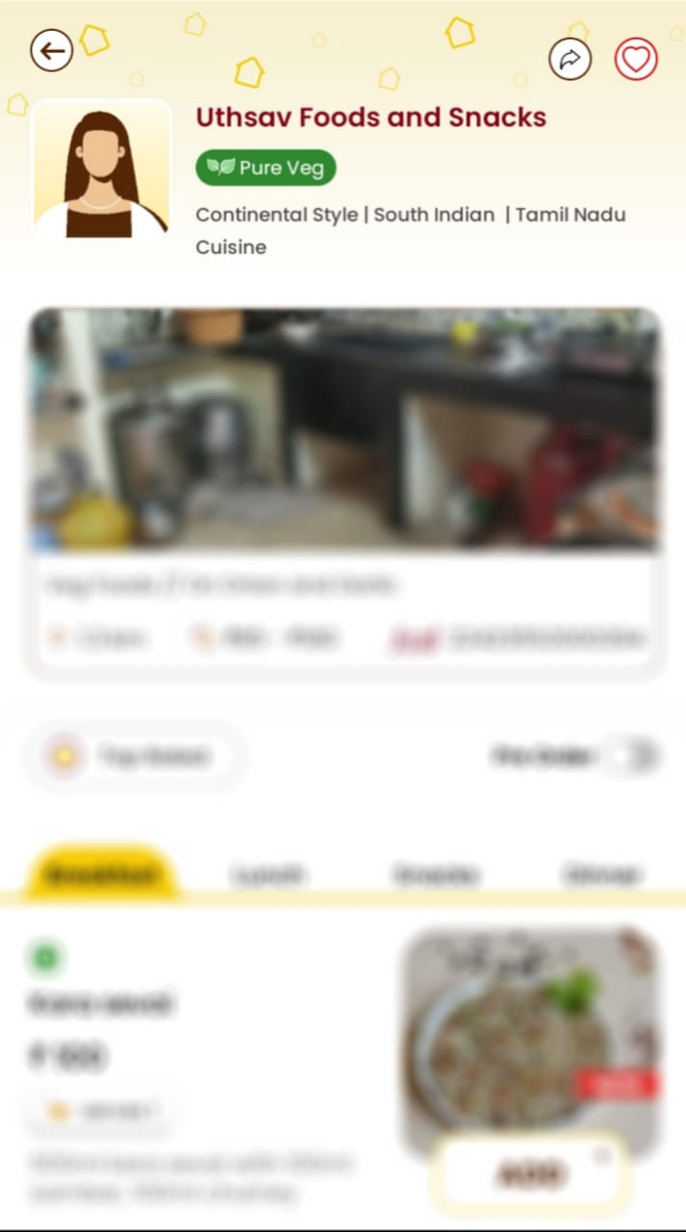
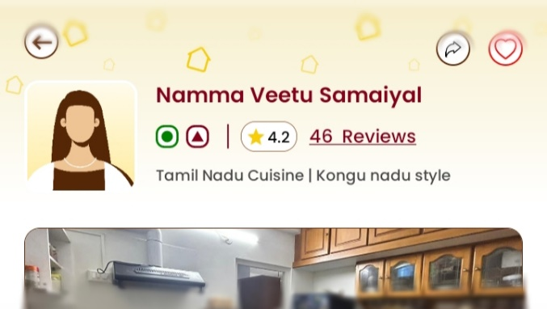
KEYWORD INTO PROPER DESCRIPTION

Slide 8
OUTPUT DESCRIPTION
FOR EXAMPLE: (INPUTS FROM KITCHEN CHEF)
TAMILNADU CUISINE , CHETTINADU STYLE AND NON VEG SPECIALS
THE FINAL OUTPUT WILL BE :
“Savor the authentic flavors of tamilnadu with a diverse menu of chettinadu dishes, each showcasing the kitchen's mastery of nonveg specials.”

Slide 9
THANK YOU FOR YOUR ATTENTION…

